Slide 2
Brainstorming:
Membership Development
Who would you work with and How?
Retain and Rejuvenate
Benefits?
Homework
What will you implement at your chapter?
Review video cast for membership development:
Membership_development/md2016archiveguide
Volunteer kit for recruitment: Volunteer_recruitment_toolkit

Slide 3
Who will you work with and How
Note: This table is NOT a 1-1 answer
WHO | How | Link
Section
YPs (Society AND Affinity Group) Students/Student Branch Chapters (SBC) | Presentation (with food), Social Activities | Be a Speaker at the SBC/YP/WIE session Congress. R8 (once every 2 years, summer), R9 (once every 2 years), R10 (every year, summer), R6 (once a year at Las Vegas before CES in January) Get involved with IEEE STEP (Student Transition & Elevation Partnership) such as be a panelist at a College through their Student Branch. https://www.ieee.org/societies_communities/geo_activities/volunteer_recruitment_toolkit.html
Sister Societies | IEEE TV | https://ieeetv.ieee.org/
EMC Associations, Universities, City Council | Professors, Open House, presentations (with food) | webinar series – Young Professionals https://www.ieee.org/membership_services/membership/young_professionals/events/index.html
Active members, Section | eNotice (vtools) = Newletter sent to all your members (automatically add new members) | http://www.ieee.org/about/volunteers/enotice/enotice_index.html
 | Collaboractec for volunteers | IEEE Collaboratec https://ieee-collabratec.ieee.org/),
Distinguished Lecturer , engage successful people in the industry |  | http://www.emcs.org/dl-main.html
EMC Society |  | Depends on the need, contact appropriate officer
Technical Advisory Committee |  | http://www.emcs.org/committees/tac/
Technical or professional Activities | Angel Funds (for needy chapters) | http://www.emcs.org/chapters/haislmaier.html
Companies (EMC Test labs, local industry) | Sponsorship/fundraising/mini symposium | For food during meetings or annual sponsorship and recognize them,

Slide 4
Example of eNotice
Lots of valuable information inside for volunteers and Awards

Slide 5
Retain and Rejuvenate
Membership Deactivation/Arrears (SAMIEEE using vtools)
Associates to Member: http://www.ieeer8.org/category/membership-development/
Senior Member Elevation IEEE Senior Elevation
Membership Discount/ referral
(IEEE Membership Referral and Discount (new Members to IEEE))
Survey
Loyalty Pins (recognize new and long time members) IEEE Loyalty Pin Program
Certificate of Recognition and Award (individual, section, and companies, friend of IEEE (does not have to be a member))
MGA Award and Recognition Program
IEEE USA Award Program (Professionalism and Technical awards)
Title (not volunteer but Webmaster or Director of Social Media, title provides the importance of the position and Recognition)
Sponsor a potential (active) volunteer to an event
One-day seminar (with or without exhibitor, fees or no fees for admission) – meet new members/good speakers
Mentoring
Social media/Translate material in the local language
Change of venues and presentation style (museum, outdoor, etc)

Slide 6
Benefits
Leadership/Management Role/Do something you don’t have the opportunity to do it at work/school
Good Young Professionals List so that YP volunteers can go to different positions by nomination from other people that might not know this person http://yp.ieee.org/volunteers/good-young-professionals-list/
Hundreds of Volunteer Roles among IEEE (not just EMC)
Technical/Professional presentation/publication (https://ieeetv.ieee.org/ondemand/emc some free lecturers for EMC Members and fees for non EMC members)
Job and Internship Opportunities (IEEE Collabratec https://ieee-collabratec.ieee.org/)
Job Fair (tag along with local events)
Networking with people in the same field, professional development
To be exposed to new technology as well as established tech
Discount on Conference fees, symposium proceedings
Increase self-esteem
Non technical benefits like insurance

Slide 7
Benefits
Scholarship (Scholarship Grant and Fellow (might be specific to society) and also ask your section if they offer any particular ones for local Universities)
IEEE Competition (EMC for Student Hardware, contact ESAC)
First time student presenter grant to come to the IEEE EMC Symposium – Contact VP of Member Services (Vignesh Rajamani, vignesh@ieee.org)
Grant for financial hardship for presenters - Contact VP of Member Services (Vignesh Rajamani, vignesh@ieee.org)
IEEE Mentor Center:
http://www.ieee.org/membership_services/membership/mentoring/index.html
Resume lab: http://www.ieee.org/membership_services/membership/resumelab.html
Develop your resume or curriculum vitae (CV)
Letters (cover letter, thank you letter, etc)
Portfolio of work
Skills assessment
Mock Interview (you can record yourself)
Video Resume to potential employers

Slide 8
A Real Story from the IEEE Young Professionals:
from Graduation to a satisfying job
https://www.ieee.org/societies_communities/geo_activities/sections_congress/2014/sc2014_enhance_embracing_young_professionals.pdf

Slide 9
Collabratec
https://ieee-collabratec.ieee.org/
What is Collabratec?
The IEEE Collabratec Branding and Communications Toolkit is a marketing resource for promotions and communications in connection with IEEE Collabratec. This toolkit explains how to use IEEE Collabratec brand elements and offers resources for creating strong and consistent communications pieces while supporting the IEEE brand.
Targeted at both IEEE members and non-members, including authors, researchers, and volunteers, IEEE Collabratec helps users:
Connect with global technology professionals by location, technical interests, or career pursuits
Access research and collaborative authoring tools
Establish a professional identity to showcase key accomplishments
IEEE Collabratec also helps IEEE volunteers:
Build and manage their IEEE volunteer network
Build communities and engage technology professionals in real time
IEEE Collabratec competitively positions IEEE for the future of publishing, professional networking, and career development. IEEE Collabratec brings together IEEE and non-IEEE individuals – whether they are authors, publishers, IEEE members, or other technical professionals who have similar interests – through an integrated online community, facilitating collaboration and connectivity. All in one centralized hub, IEEE Collabratec offers these major features:
Online communities
Author and researcher tools
Career development networking opportunities

Slide 10
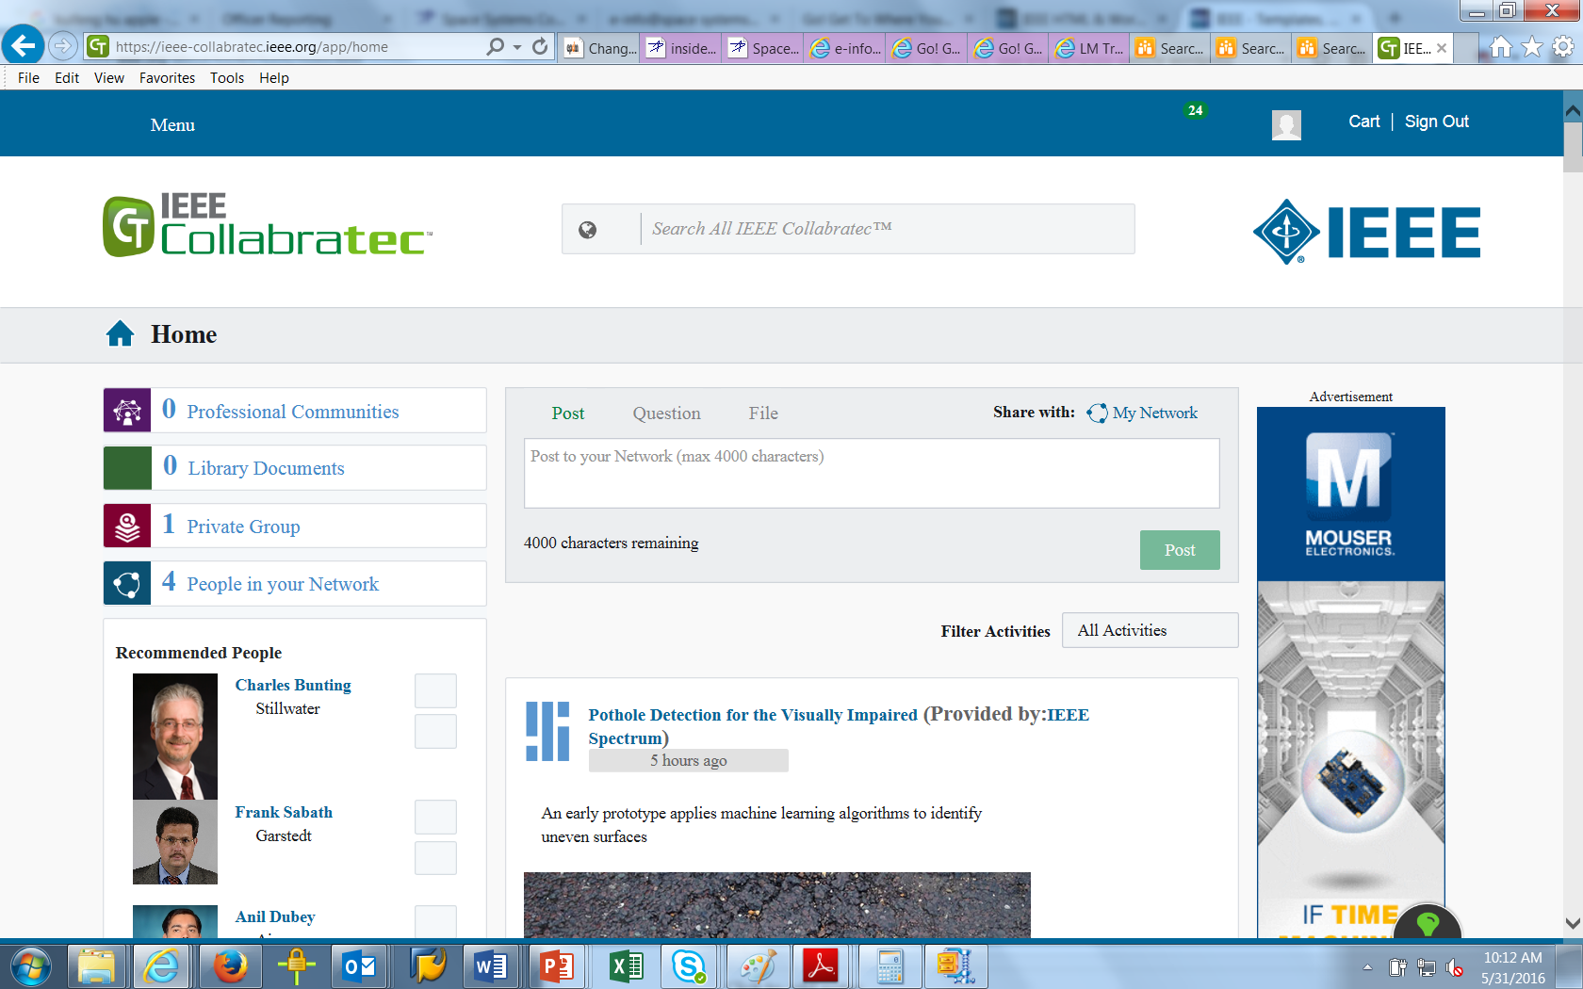
Collaboratec
Used as a working forum for a small group. Does NOT work for the public.
You can create a group, upload a document for review.

Slide 11
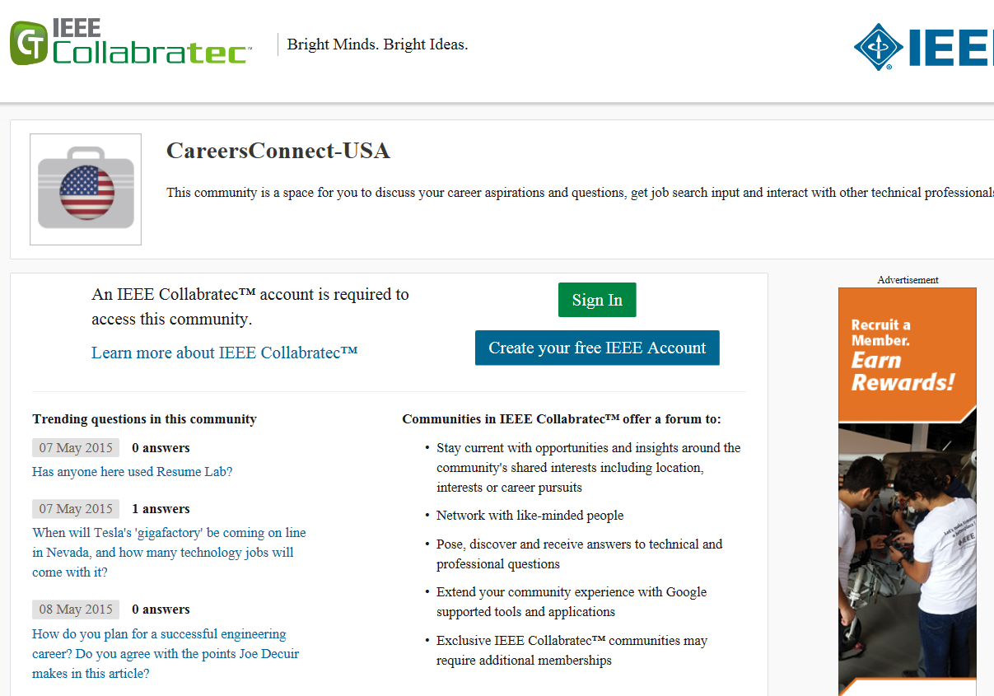
Collaboratec

Slide 12
Collaboratec: Job Opportunities

Slide 13
Homework
What will you implement for your chapter?

Slide 14
Questions?
Contact Caroline Chan, IEEE EMC-S Chapter Coordinator or your Angels
caroline.chan.us@ieee.org
Each Chapter has an Angel. Please get familiar with who your Angel is.

Slide 15
Questions?
Contact Caroline Chan, IEEE EMC-S Chapter Coordinator or your Angels
caroline.chan.us@ieee.org
Each Chapter has an Angel. Please get familiar with who your Angel is. http://www.emcs.org/chapters_main.html -> Chapter Angel List (To be updated for 2016)

